Slide 1
Professor Anil Kokaram
Anil.Kokaram@tcd.ie

Slide 2
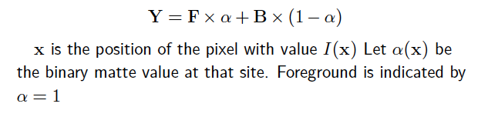
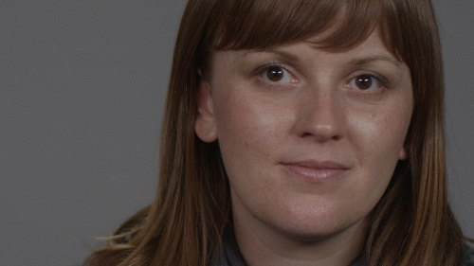
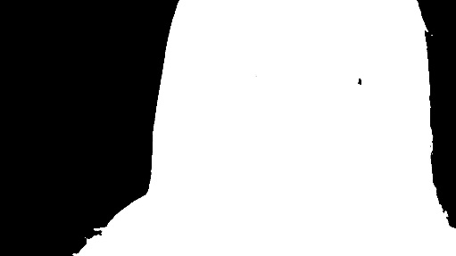
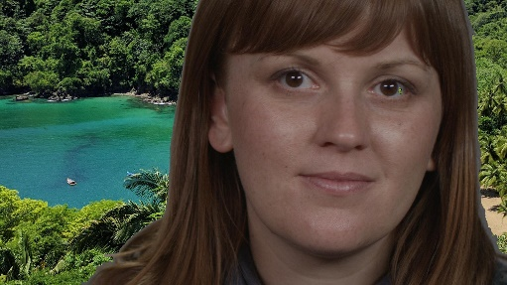

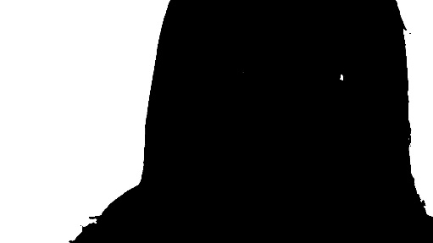
Colour Keying
Binary Matte
Foreground
Background

Slide 3


MAXIMUM LIKELIHOOD
MAP

Slide 4
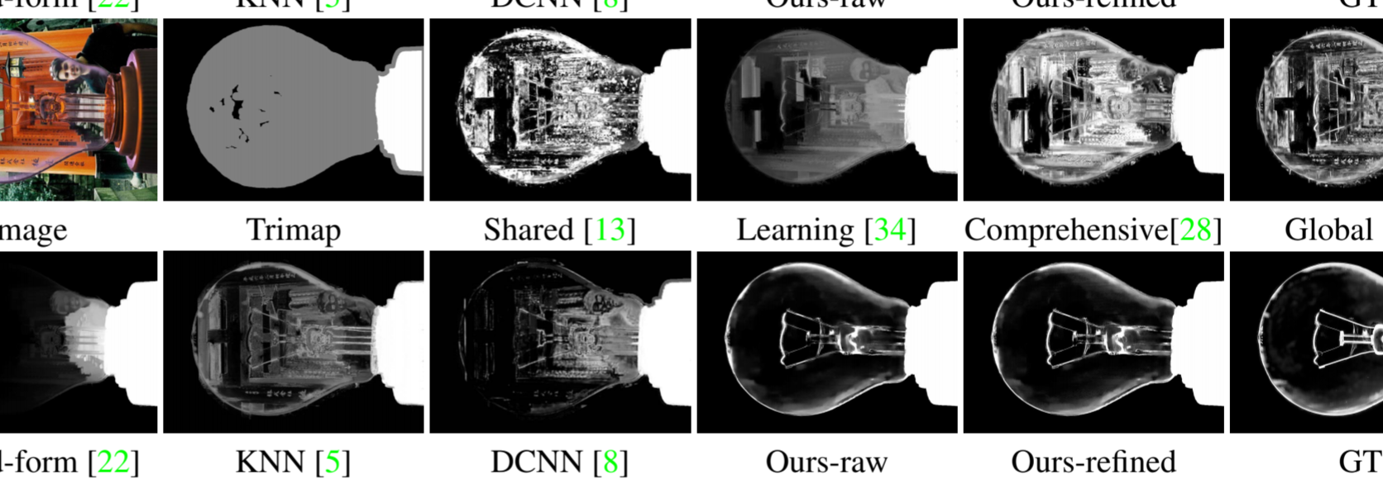
Levin’s success can explain why a DNN can work

Slide 5
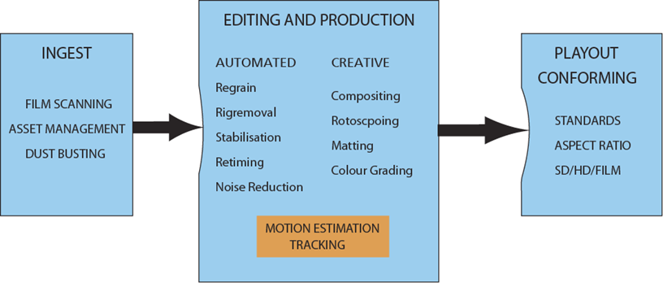
Recall the pipeline : We need to process video sequences not stills

Slide 6
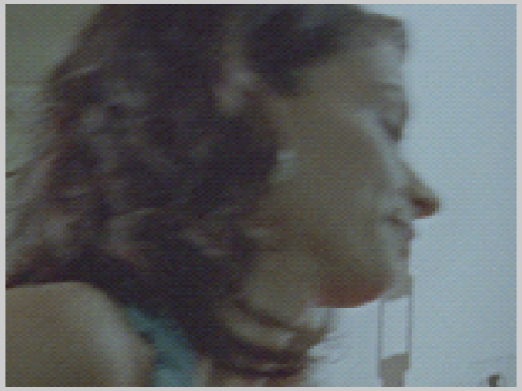
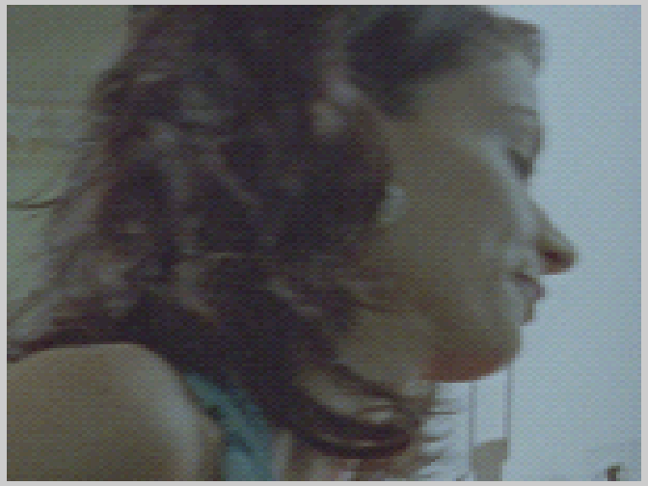
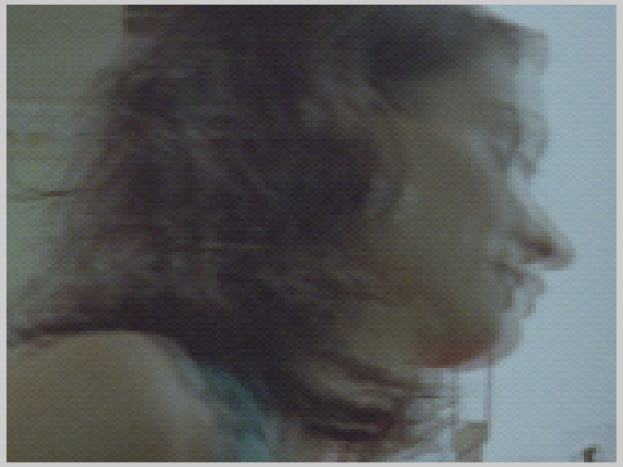
Frame Rate Conversion Inbetweening, Retiming
Current
Next
Blurring due to motion
(Current+Next)/2
If we don’t take motion into account : video processing doesn’t work well

Slide 7
Products and Applications
Video Compression Standards : HEVC, VP9, H.264
Restoration/Conditioning
DustBusting, Stabilisation, Line Removal, Denoising
Broadcast Glue
Denoising, Standards Conversion
Fx
Matting, RigRemoval, Inbetweening/SloMo, Compositing

Slide 8
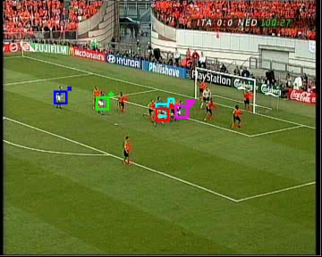
Not tracking
Frame n-1
Frame n
Finding/maintaining “lock”
Usually sparse semantically meaningful object/s
Requires initialisation
MOTION
ESTIMATION
Tracking

Slide 9

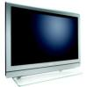

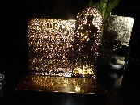
History : Industry
Philips Put Motion Based Conversion into TV
Huang et al think about Video Compression
Broadcast Apps
MPEG2 Happens
1980
1990
1995
1998
2000
BBC
IPTV SONY eyeCam
Dubois et al think about noise reduction
Motion Compensated Restoration happens at UCAM
DTV and DVD Takes off
S&W make motion compensated converters. Farjouda Labs close
The MATRIX popularises motion based fx in movies
2D3, Foundry, ESC
ReVisionFX
2006 Optical Flow in the movies www.fxguide.com/featured/art_of_optical_flow/

Slide 10
History : Academia
DeHaan 1998
Important person 3DR-BM
Variational Bayes
Graph Cuts
Sparse to Dense
Coding/DSP
Bayesian Methods
CV+DSP
RAFT
Optic Flow/CV
2020
70’s
80’s
90’s
00’s
Deep Neural Nets
1974
1979
1981
1984
1992
1994
Brox et al
Zabih et al
2011
2015
Konrad and Dubois
Black and Anandan
FlowNet
Haskell PhC
L-Higgins, H-S, N-E,
Lukas Kanade
Netravali Robbins
Pel recursion
Barron et al
Biemond
vision.middlebury.edu/flow/eval/
Scharstein Lewis et al
B. Pesquet-Popescu, M. Cagnazzo, F. Dufaux. Motion Estimation Techniques.
In Elsevier E-Reference Signal Processing, 2014.

Slide 11



Key Community Milestones
Middlebury Evaluation Dataset IJCV/CVPR 2001/2 Scharstein et al
Big Buck Bunny https://www.blender.org/foundation/
Sintel MPI database of synthetic video and ground truth flow fields http://sintel.is.tue.mpg.de/ (ECCV 2012)

Slide 12
Key Community Milestones
It is difficult to use the Computer Vision community ground truth flow fields for actual video processing that tries to improve pixel quality.
This is because of the direction of the flow and the reference positions for the matching between frames.
Those flow fields are meant to compare optic flow estimation and don’t really say much about usefulness in applications

Slide 13
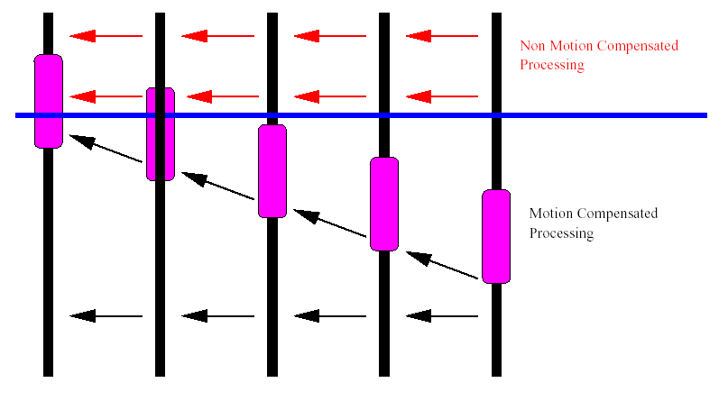
Motion Compensated Processing

Slide 14
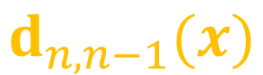
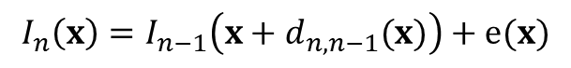
Basics : The Rubber Sheet Model and Flow
$$d_{n,n−1}(x)$$
A function or tensor which expresses or stores the motion at every pixel is referred to as a Flow Field or a Motion Flow Field
Frame n-1
Frame n
We want to estimate the motion at every site in the frame. This is a “Dense Flow Field”.
In a way this equation assumes that all pixels “flow” from one frame into the other like water.
$$I_{n}\left(x\right)=I_{n−1}\left(x+d_{n,n−1}(x)\right)+e(x)$$
$I_{n}\left(x\right)=I_{n}(\left[h,k\right])$ the value of the pixel at site $\left[h,k\right]$ in frame $n$
Computer Vision (Comp Sci) Literature calls this Optic Flow estimation
Video Processing (DSP/Engineering) Literature calls this Motion Estimation

Slide 15
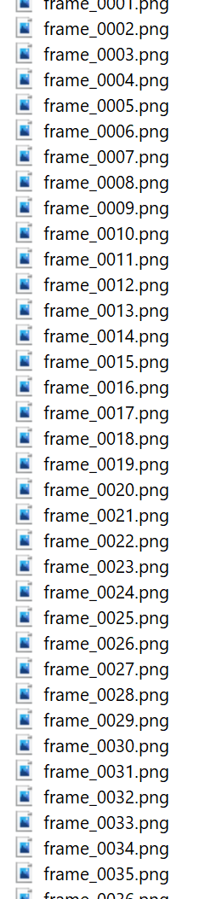
Basics : Sequence Storage
In cinema, television editing, postproduction sequences are stored as NUMBERED FILES (tiff, exr, cin (cineon) most common)
For most consumers, image sequences appear as a single file containing compressed frames e.g. .mp4 or .mov . Netflix, YouTube, Amazon ingest .mov and .mp4.
Processing frame sequences like this means you have to get comfortable with string handling in Python/C/Matlab.

Slide 16
Basics : How to make good figures showing motion
Just use Matlab.
“Quiver” is your friend
“Image” and “hold on” are your other two friends.
So many people have trouble figuring this out that I will show you how to do this.
Problems
What is the origin of the coordinate system?
Is the top left of the image [0,0]?
Is the bottom left of the image [0,0]?
If you are reading a flow field are those vectors stored by scanning from the top left downwards or from the bottom left upwards?
NUKE uses the bottom left of the image as the origin
Matlab uses the top left (most video streaming applications use this convention)

Slide 17
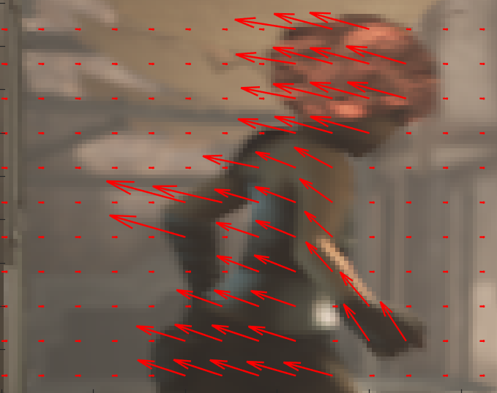
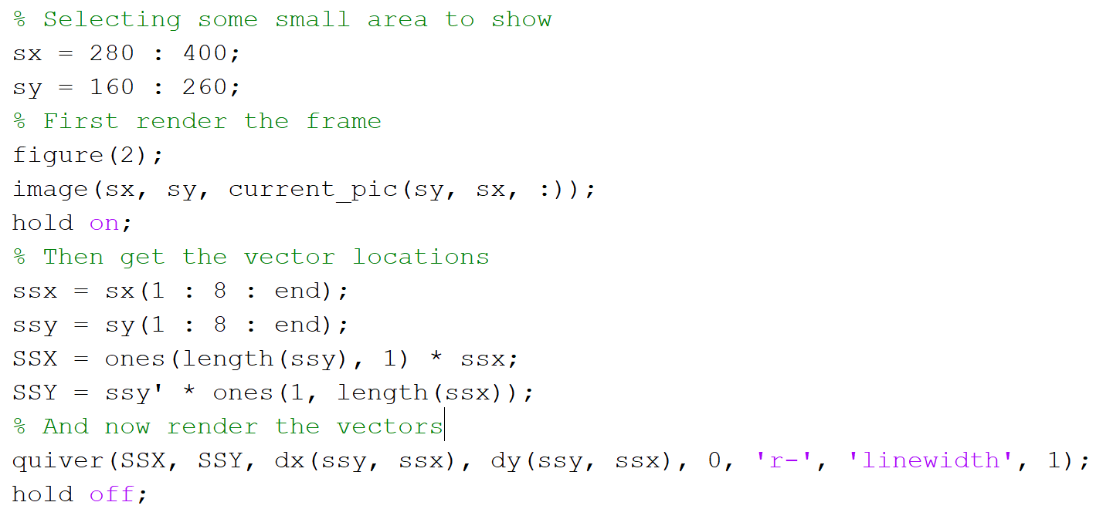
Showing motion vectors
The location of each vector
The vector components

Slide 18
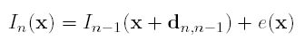
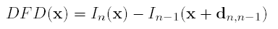
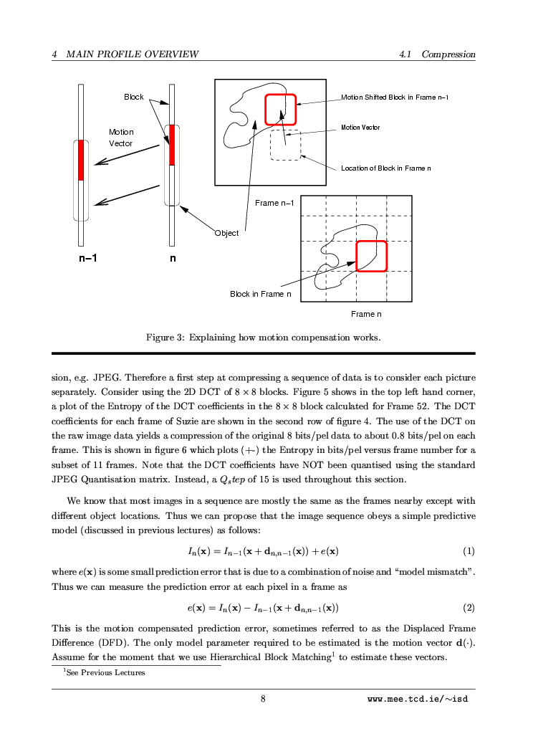
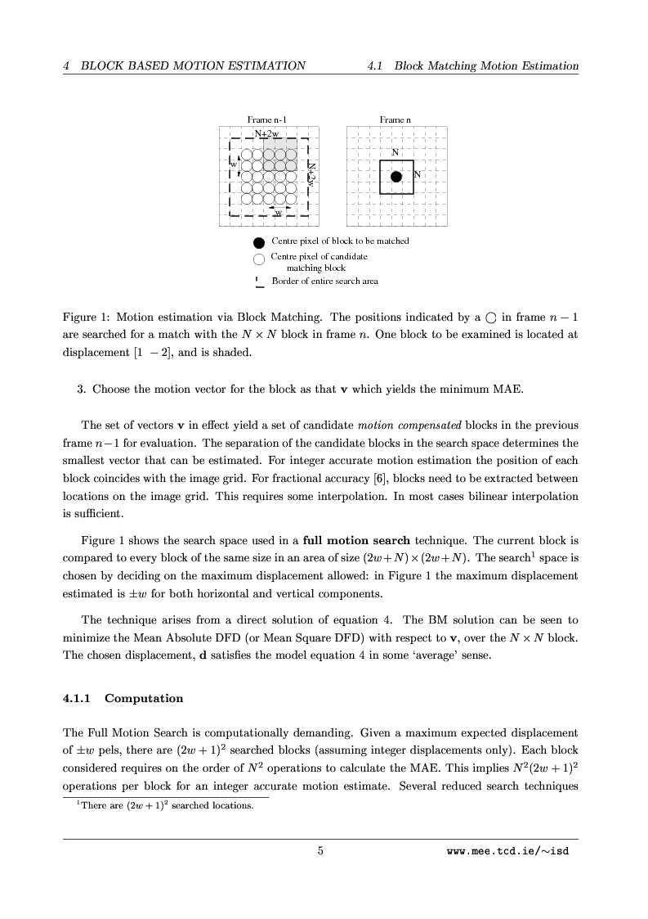
Block Matching
Direct solution

Slide 19
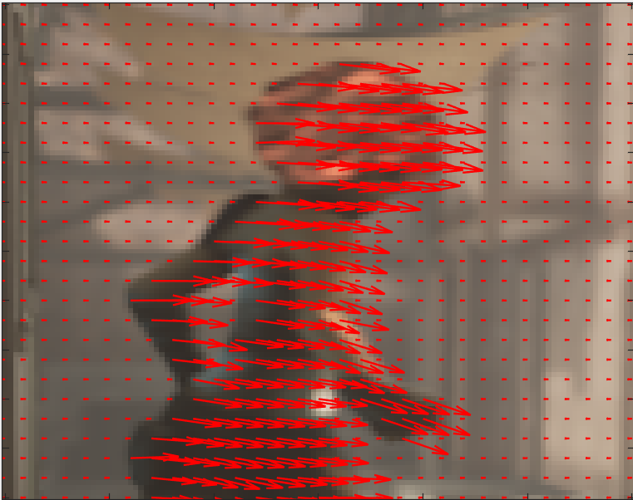
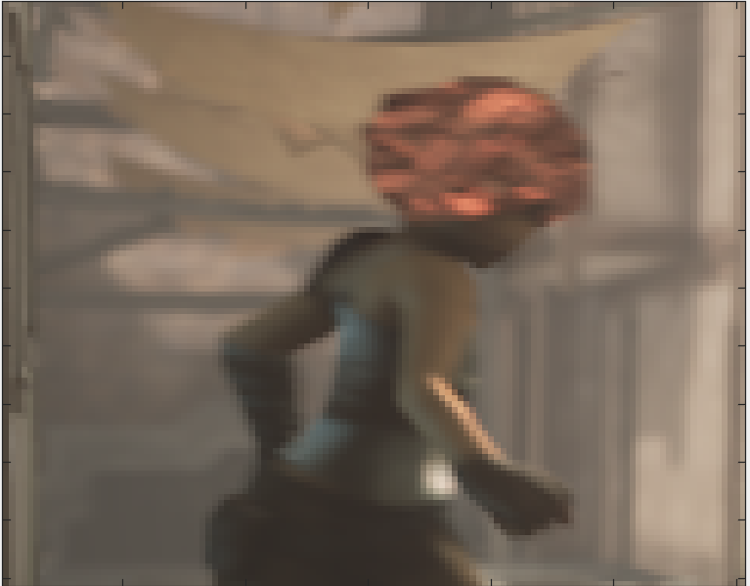
Real Motion is Fractional!
Frame 1
Frame 2

Slide 20
So you need to search Fractionally
Block Matcher integer accurate searches +- w pixels
So say w = 3 then we search (-3, -3), (-3, -2), (-3, -1) … ( 3, 3)
But now we need to search fractionally i.e. fractionally accurate motion search , say w = 3; and accuracy = 0.5
Our search space is (-3, -3), (-3, -2.5), (-3, -2), (-3, -1.5) … (2.5, 3), (3,3)
That implies INTERPOLATING PICTURE VALUES to figure out the pixels in the block in the previous frame

Slide 21
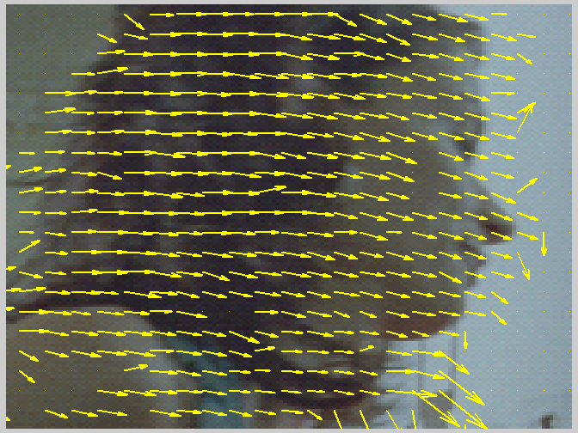
Block Matching Shortcomings
Motion inside an object
is rarely so un-smooth
Spurious vectors when picture is flat

Slide 22
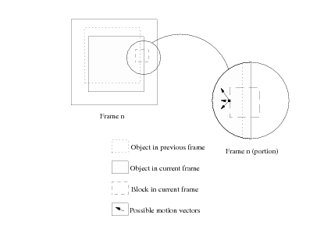
The trouble with blocks

Slide 23
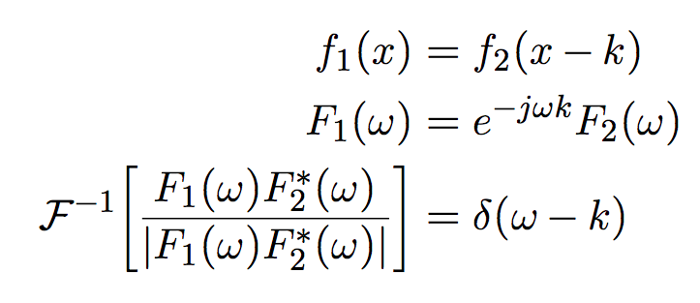
Phase Correlation

Slide 24


Phase Correlation
$$\frac{F_{1}\left(ω\right)F_{2}^{∗}(ω)}{{|F}_{1}\left(ω\right)F_{2}^{∗}\left(ω\right)|}=\frac{e^{−jωk}F_{2}(ω)F_{2}^{∗}(ω)}{\left|F_{2}\left(ω\right)F_{2}^{∗}(ω)\right|}=e^{−jωk}$$
$${⇒ℱ}^{−1}\left[e^{−jωk}\right]=δ(ω−k)$$

Slide 25
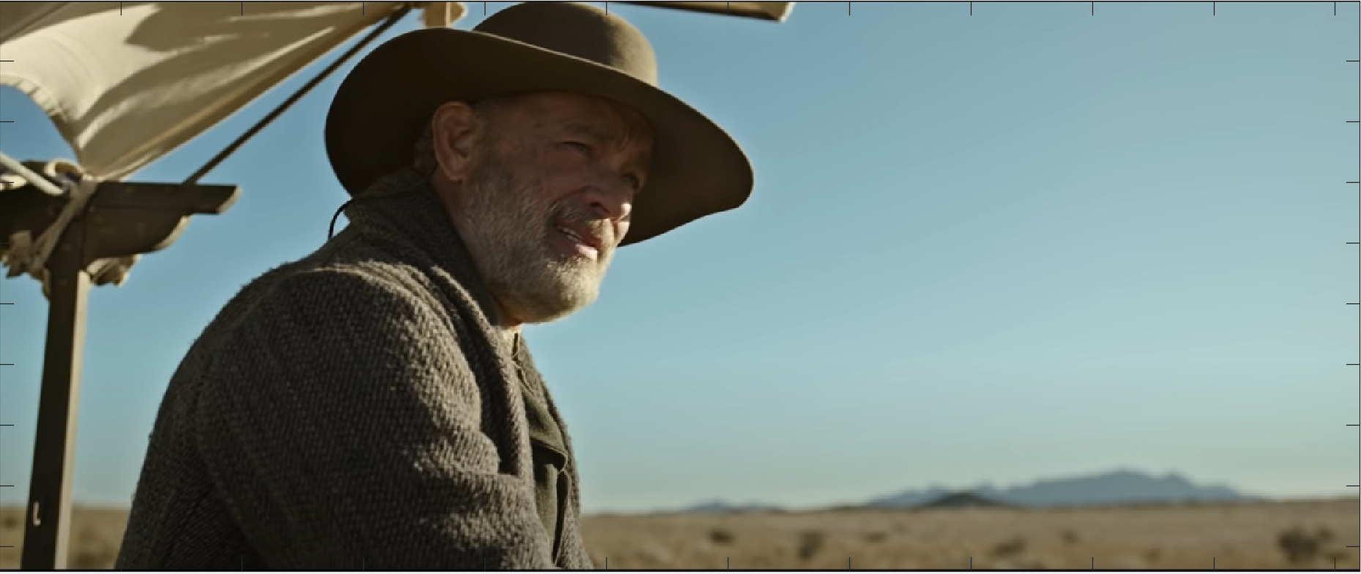
Frame 1

Slide 26
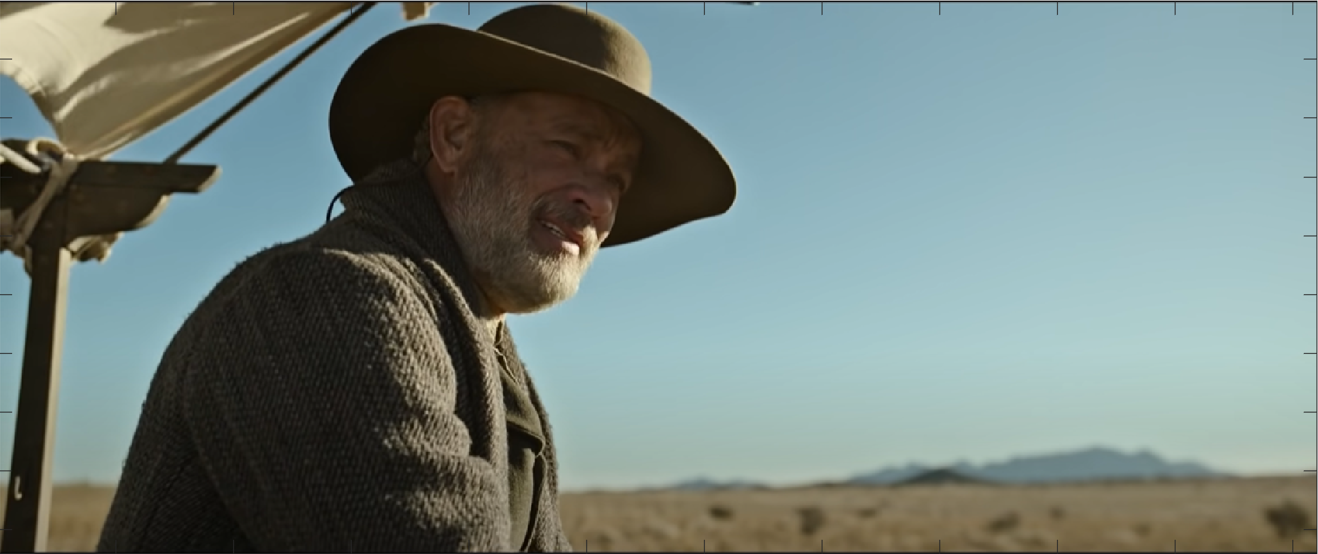
Frame 2

Slide 27
Block in Frame 1

Slide 28
Block in Frame 2

Slide 29
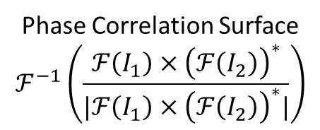
Only using the Green Channel
Motion = [13, 13]
FFT of Block 1
Phase Correlation Surface
$$ℱ^{−1}\left(\frac{ℱ\left(I_{1}\right)×{\left(ℱ\left(I_{2}\right)\right)}^{∗}}{|ℱ\left(I_{1}\right)×{\left(ℱ\left(I_{2}\right)\right)}^{∗}|}\right)$$
FFT of Block 2

Slide 30




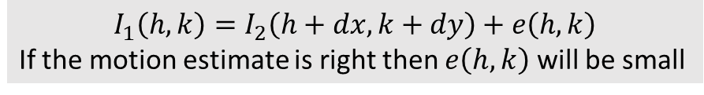
How good is the estimate? Motion Compensation Error
Motion Compensated Previous Frame
Motion Compensation Error
$$I_{1}(h,k)$$
$$I_{2}(h+13,k+13)$$
$$I_{1}\left(h,k\right)− I_{2}\left(h+13,k+13\right)$$
Why the black border?
Why isn’t this error all 0?
MSE = $∑{\left(I_{1}\left(h,k\right)− I_{2}\left(h+13,k+13\right)\right)}^{2}$= 173.95
PSNR = $10$log10$\left(\frac{{255}^{2}}{MSE}\right)=25.73 db$
$$I_{1}\left(h,k\right)=I_{2}\left(h+dx,k+dy\right)+e\left(h,k\right)$$
If the motion estimate is right then $e\left(h,k\right)$ will be small

Slide 31



Non-motion compensated error
Previous Frame
Frame Difference
$$I_{1}(h,k)$$
$$I_{2}(h,k)$$
$$I_{1}\left(h,k\right)− I_{2}\left(h,k\right)$$
We can use this signal to detect motion
MSE = $∑{\left(I_{1}\left(h,k\right)− I_{2}\left(h,k\right)\right)}^{2}$= 3920.02
PSNR = $10$log10$\left(\frac{{255}^{2}}{MSE}\right)=12 db$

Slide 32
Let’s look at another place in that frame

Slide 33
Frame 1

Slide 34
Frame 2

Slide 35
Frame 1

Slide 36
Frame 2

Slide 37
Motion = [-4.8, -5.5]
FFT of Block 2
Phase Correlation Surface
$$ℱ^{−1}\left(\frac{ℱ\left(I_{1}\right)×{\left(ℱ\left(I_{2}\right)\right)}^{∗}}{|ℱ\left(I_{1}\right)×{\left(ℱ\left(I_{2}\right)\right)}^{∗}|}\right)$$
FFT of Block 1

Slide 38


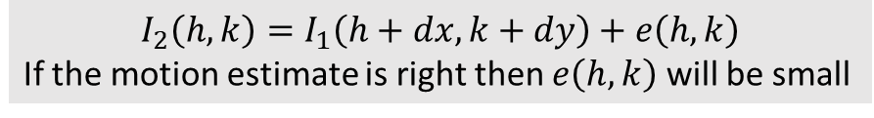


How good is the estimate? Motion Compensation Error
Motion Compensated Previous Frame
Motion Compensation Error
$$I_{2}(h,k)$$
$$I_{1}(h−4.8,k−5.5)$$
$$I_{2}\left(h,k\right)− I_{1}\left(h−4.8,k−5.5\right)$$
MSE = $∑{\left(I_{1}\left(h,k\right)− I_{2}\left(h−4.8,k−5.5\right)\right)}^{2}$= 147.02
PSNR = $10$log10$\left(\frac{{255}^{2}}{MSE}\right)=26.45 db$
$$I_{2}\left(h,k\right)=I_{1}\left(h+dx,k+dy\right)+e\left(h,k\right)$$
If the motion estimate is right then $e\left(h,k\right)$ will be small

Slide 39
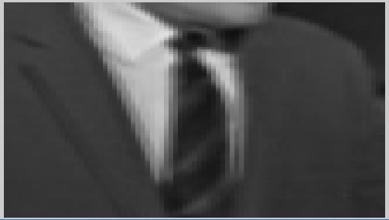
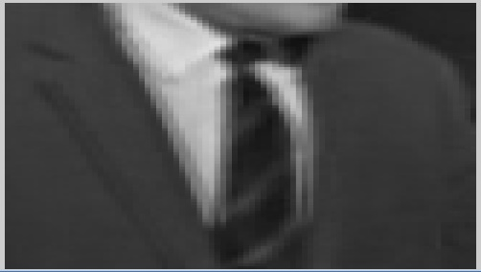
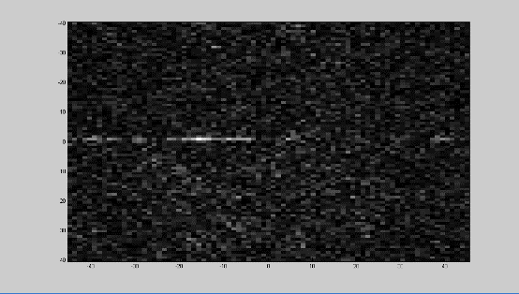
Phase Correlation
Measure correlation between large blocks in images directly with the FFT
Peaks in correlation surface determine motion
Multiple motion causes alternate peaks
Good robustness to luminance variations
No access to image based diagnostics implicit in the scheme
dy
dx
Previous
Current

Slide 40
Observations in general
Translation over a big block doesn’t reflect exactly what could happen
Zoom, rotation etc more likely as block gets bigger
Motion compensated prediction error important in assessing performance
Fractional motion implies interpolation of previous image
Notice how occlusion and uncovering not well explained

Slide 41
Hence Dense Flow (Optic flow) Per pixel or per-block vectors
These are 16 x 16 blocks
The picture is 720p
Aspect Ratio 16:9
45 x 80 blocks

Slide 42
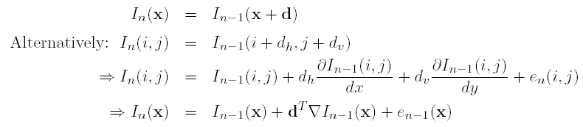
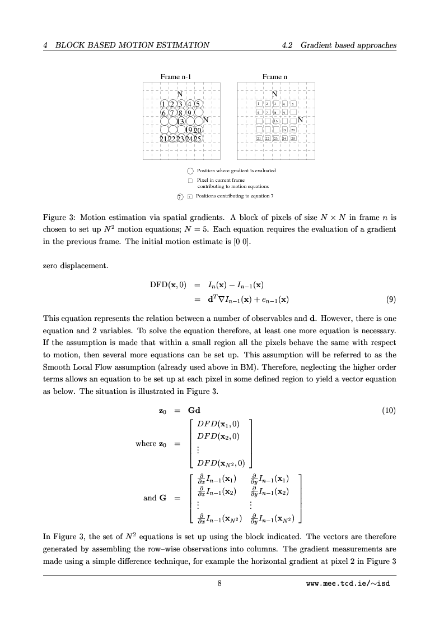
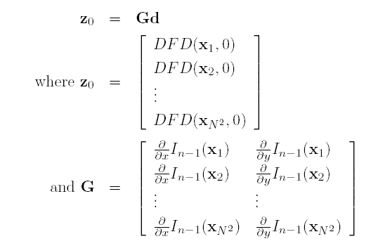
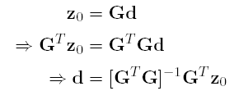
Gradient based motion estimation
An iterative Image Registration Technique with an application to stereo vision, Bruce Lukas and Takeo Kanade, Proc. 7th Joint Conf on Artificial Intelligence, Aug, 1981
A pel-recursive Wiener-based displacement estimation algorithm, J Biemond et al, pp 399-412, Dec 1987

Slide 43
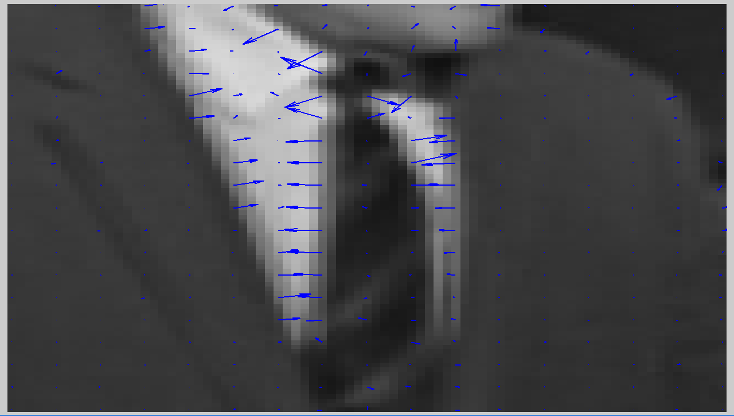
Mitigating aperture a little.
Conditioning of GtG very informative
Take small steps, remeasuring gradients every time
Iterative, converges on a good estimate of motion.
Martinez and Lim ‘90
Using eigenvectors of GtG to work out best direction for motion fallback

Slide 44
See demo gradbased.m

Slide 45
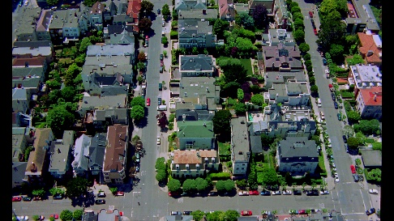


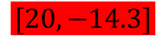



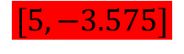
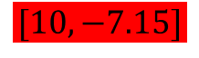
Pyramids for large motion
Motion at lowest resolution now 4 times shorter than at the original resolution
So gradient based motion estimation works better at that small resolution.
We can refine the motion estimate at subsequent levels of the pyramid.
Estimate motion at Level 2
Propagate that motion into Level 1 (i.e. scale by 2 and interpolate into the missing sites)
Refine the motion at level 1 starting from the initial estimate from Level 2 (above)
Propagate that motion from Level 1 to Level 0
And refine at Level 0
$$[5, −3.575]$$
$$480×270$$
Level 2
$$[10, −7.15]$$
$$960×540$$
Level 1
$$[20, −14.3]$$
$$1920× 1080$$
Level 0

Slide 46
None of these work on their own

Slide 47
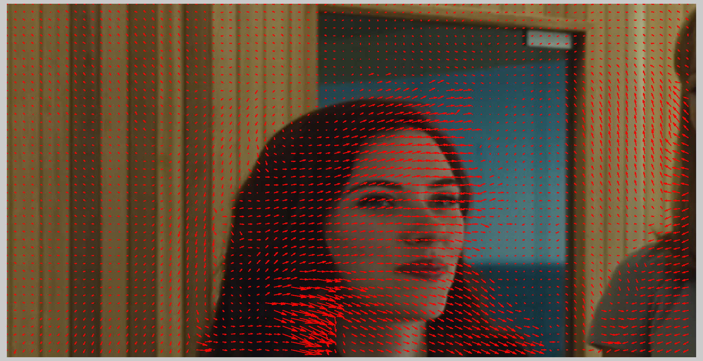
Issues with real motion
Halos, Occlusion/Uncovering, Shadows, Rotation, Zoom

Slide 48
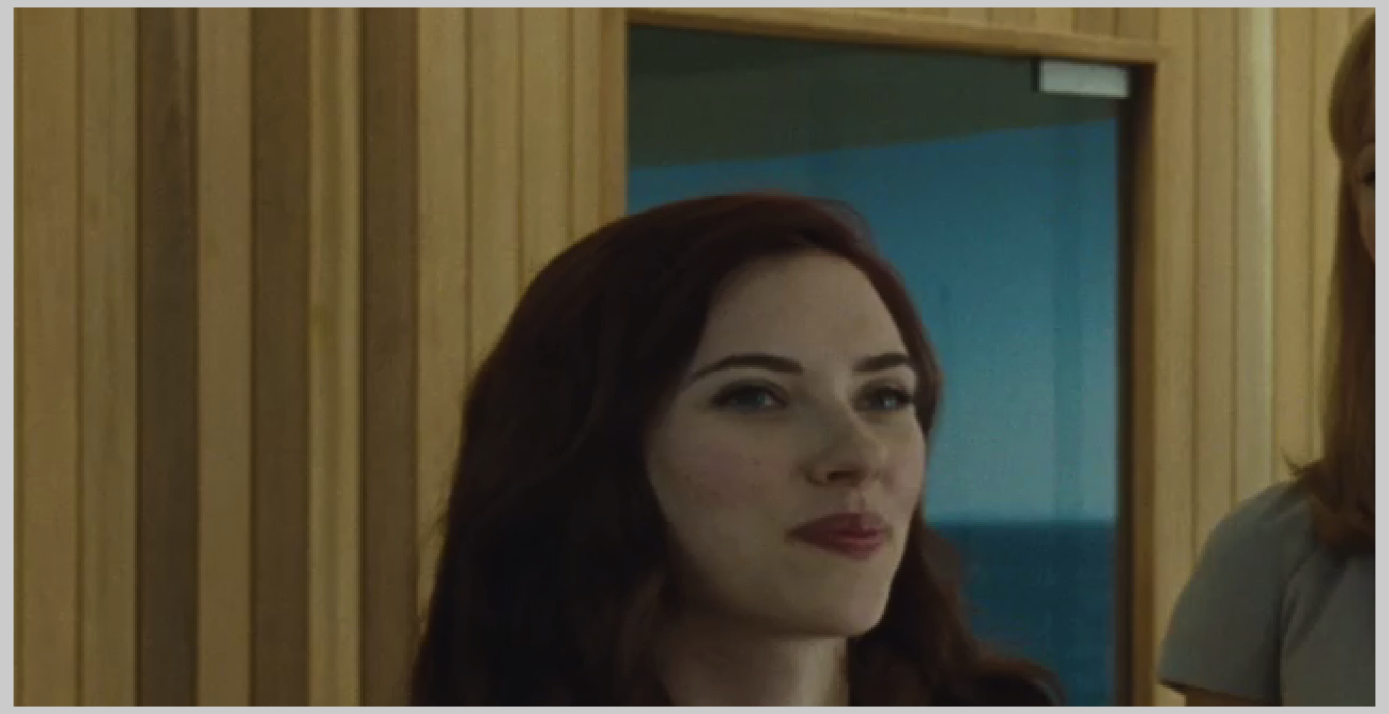

Slide 49

Simple algorithm to fix halo
Double check motion at the original resolution with a motion detection check

Slide 50
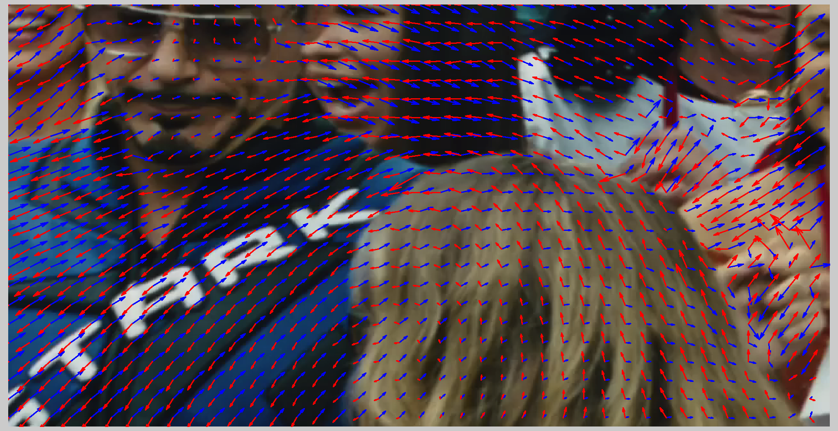
Can get even more tricksy : affine motion and occlusion
Blue vectors point forward, red vectors point backward

Slide 51
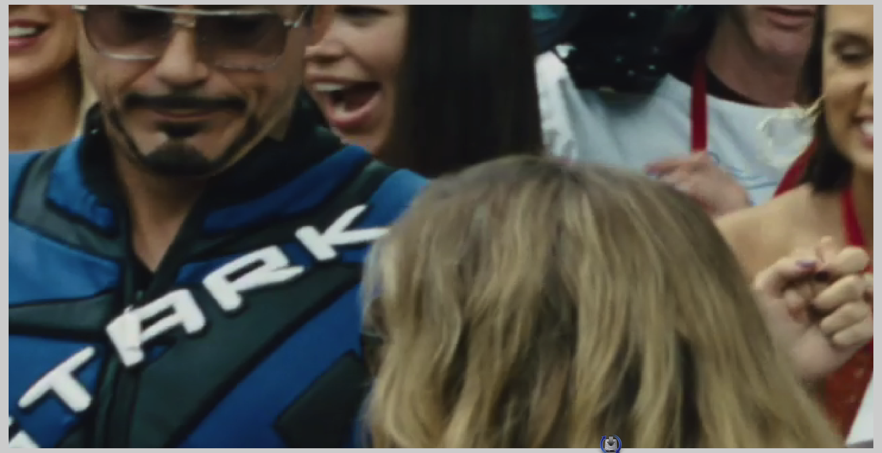

Slide 52
A Bayesian Approach
Connects Motion
With pictures
Captures what we
believe our motion fields should look like

Slide 53
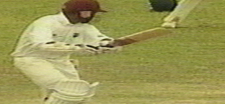


Likelihood
-

Slide 54


Priors
Classic Gibbs

Slide 55

Solution : MAP Estimate
Optimisation choices yield different schemes
Linear Optimisation e.g. Conjugate Gradients, Steepest Descent, Simplex over the whole surface
Monte Carlo : Gibbs Sampler, Simulated Annealing etc Konrad and Dubois ’92 (Bayesian Estimation of Motion Vector Fields, Konrad and Dubois, IEEE Pattern Analysis and Machine Intelligence, pp 910-927, Sept 1992)
Discrete States : Iterated Conditional Modes (Kokaram et al ’95 – ‘00), Bayesian Belief Propagation (Felzenszwalb et al ’06), Graph Cuts (Boykov et al 01’)
Brox et al : Hybrid (?), Mean Field Approximation followed by Euler

Slide 56


Pragmatic : Initialise with fast M.E then refine Candidate selection or “fusion”

Slide 57

Better?

Slide 58


Handling Discontinuities : Implicit
A framework for the robust estimation of optical flow, M. J. Black and P. Anandan, 1993 (4th) International Conference on Computer Vision, Berlin, Germany, 1993, pp. 231-236

Slide 59


Handling Discontinuities
Alter the prior at the “edges”
Split the blocks

Slide 60
Handling discontinuities: Explicit
A pixel can be in 4 states
s = 11 (Blotch/Missing)
s = 10 (Backward Occlusion)
s = 01 (Forward Occlusion)
s = 00 (No Occlusion)
s
s
n-1
n
n+1
Kokaram and Morris et al ‘94

Slide 61

More informative priors : Mirror Constraint

Slide 62
FIN

